Slide 1

PROJECT PRESENTATION
Madiyar ibrayev 16012830

Slide 2
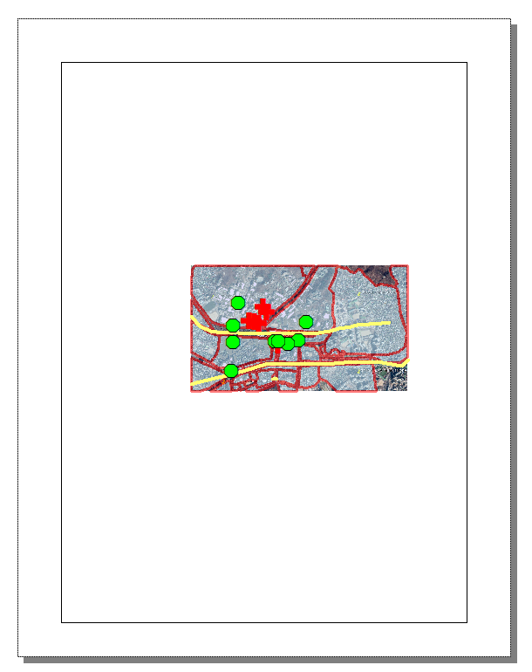
LAYOUT VIEW
Problem: to make the map fill up the borders in layout view.

Slide 3
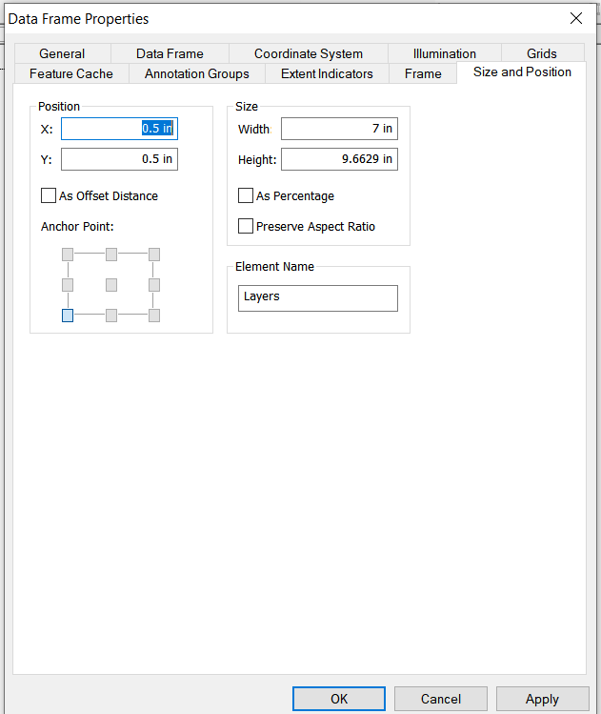
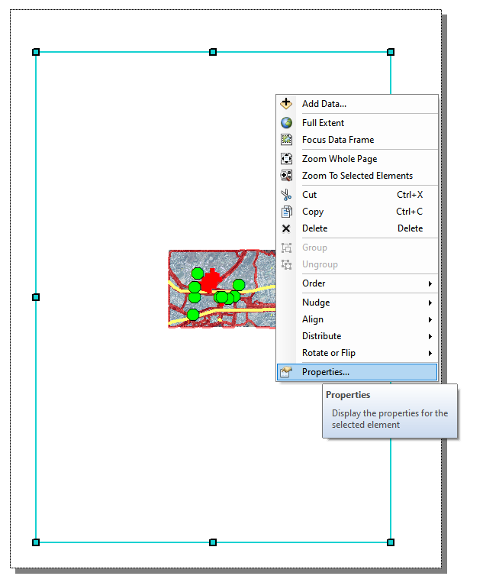
LAYOUT VIEW
To completely fill up the inside of the border with map, next steps must be done:
1) Right click and hit the properties button.
2) open size and position tab,
choose position X: 0.5 inch
and Y: 0.5 inches
3) Click to see in a full extent view
4) Choose the map scale to
1:11,000

Slide 4
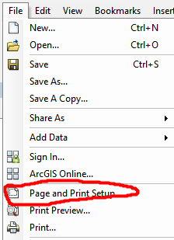
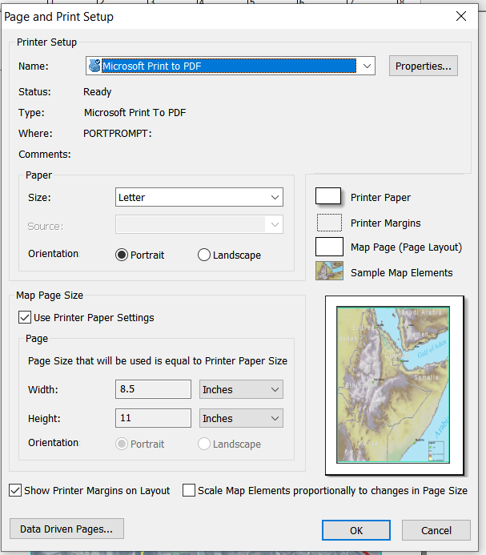
LAYOUT View
Another problem: when I set the map to 1:11,000, it cuts almost 1/2 of the map scale in portrait view.
So I had to change it to landscape view andd then rotate the map.
Orientation: Landscape.

Slide 5
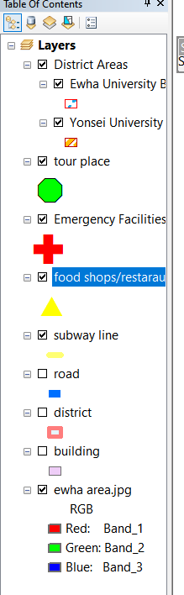
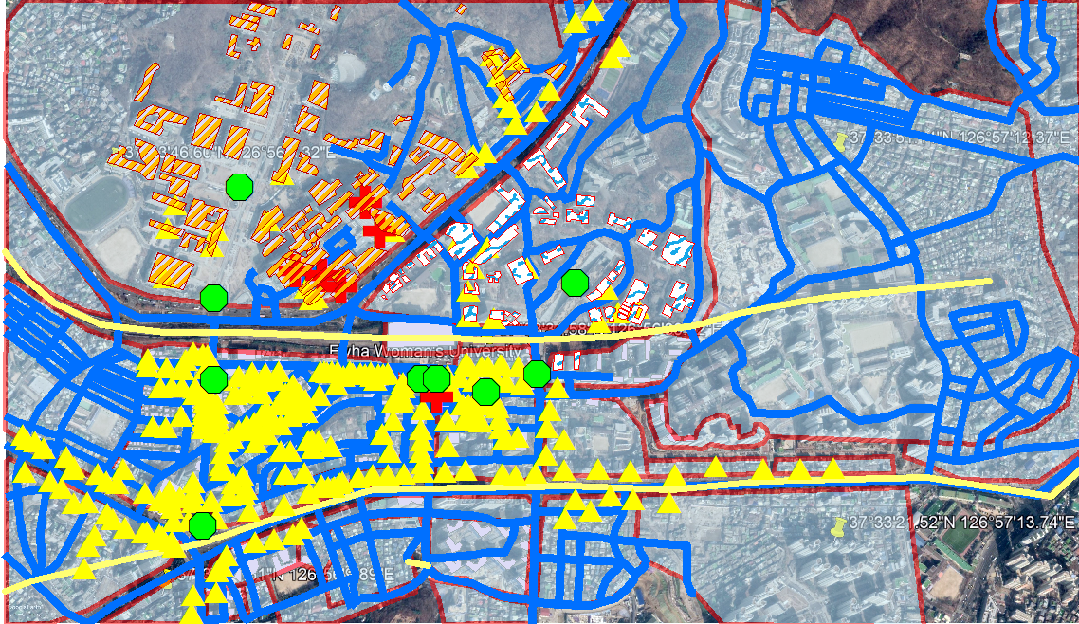
LAYERS
Data View with all layers enabled:

Slide 6
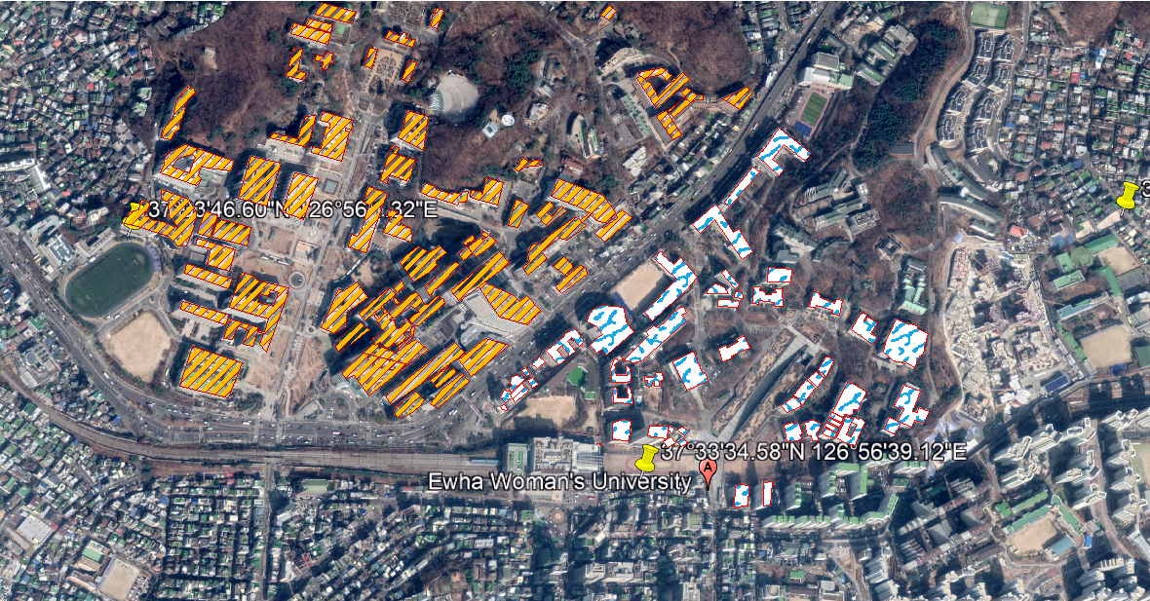
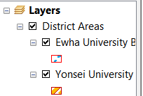
LAYERS
There are two layers that display the buildings which university they belong to.

Slide 7
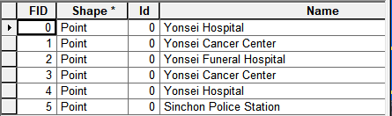
emergency facilities attribute table

Slide 8
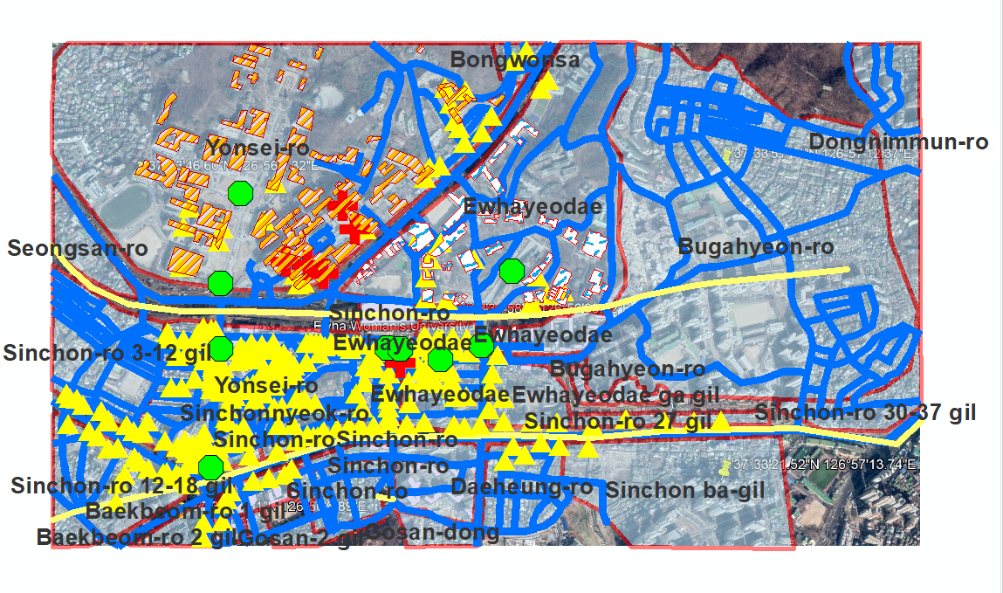
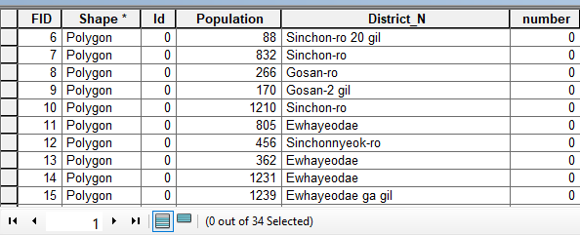
DISTRICT NAMES AND TABLE

Slide 9
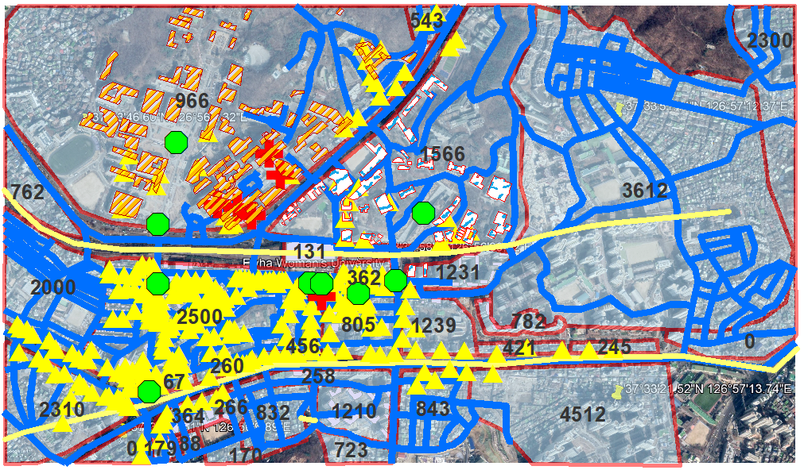
Display population of each district

Slide 10
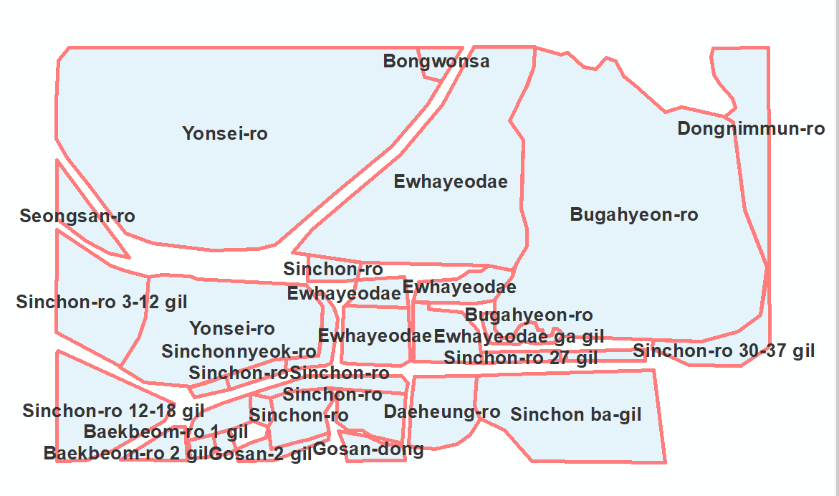
DISTRICT LAYER

Slide 11
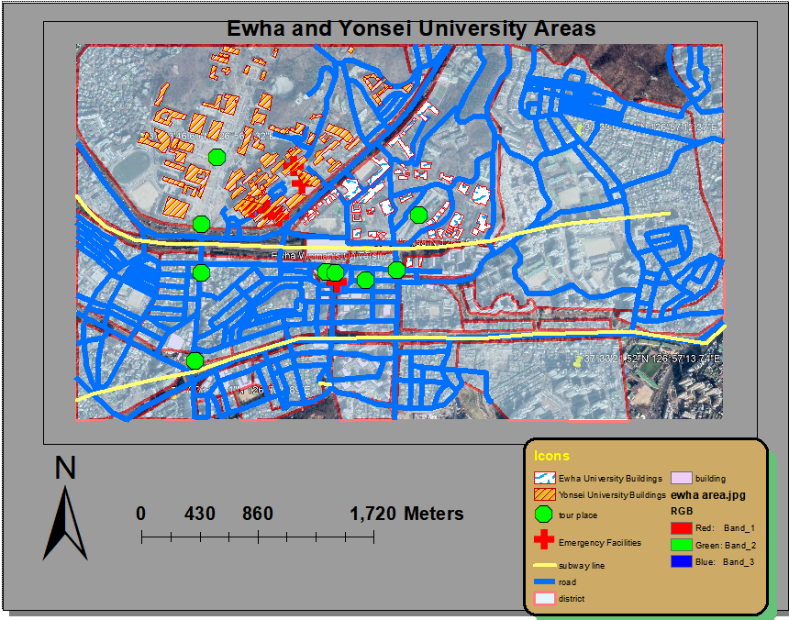
LAYERS
After doing the procedures as a being inexperience with ArcGIS, the final result of the project looks like this:

Slide 12
NUMBER OF FEATURES OF EACH LAYERS
Building layer: 434 features;
District layer: 34 features;
Road layer: 198 features;
Subway line: 6 features;
Food shops/restaurant: 284 features;
Emergency facilities: 6 features;
Tour place: 9 features;
Ewha Woman's University: 51 features;
Yonsei University: 66 features;

Slide 13
THANK YOU!

